Slide 1


STARS@SLU 2025
ORIENTATION

Slide 2
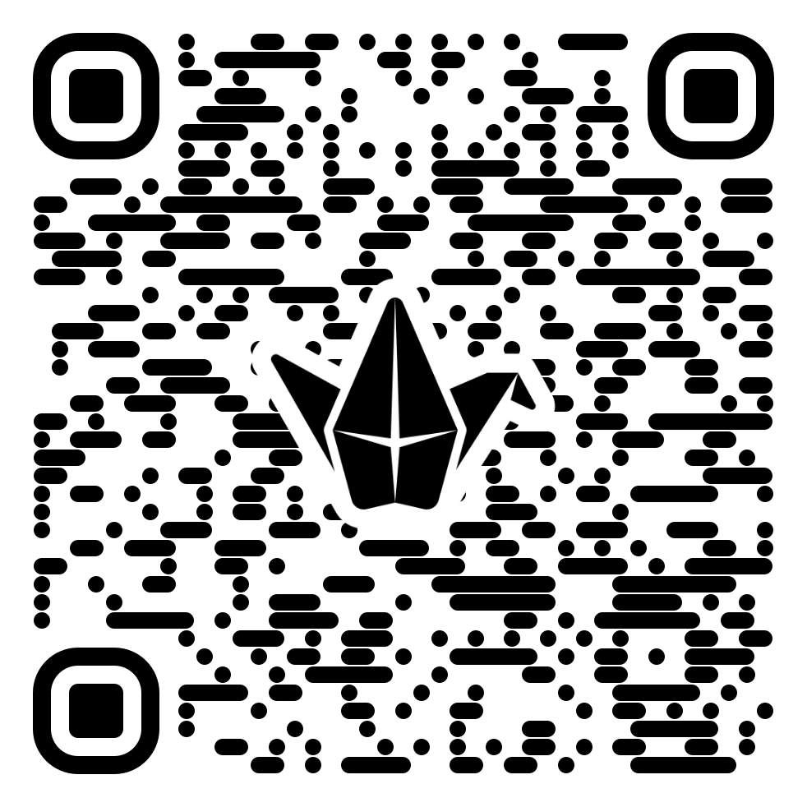
The Statistics and Research Summer Program at Saint Louis University (STARS@SLU)
Summer 2025
Program Norms
Share talk time
Listen to understand
Everyone has expertise
Be present*
Critique ideas, not people
Embrace discomfort
Treat everyone with respect
Normalize time to think / process
others? changes?
Let’s make a list for our program together!
Notes:
To ensure a respectful and productive program environment, let’s discuss, contribute to, and agree to the guidelines:

Slide 3
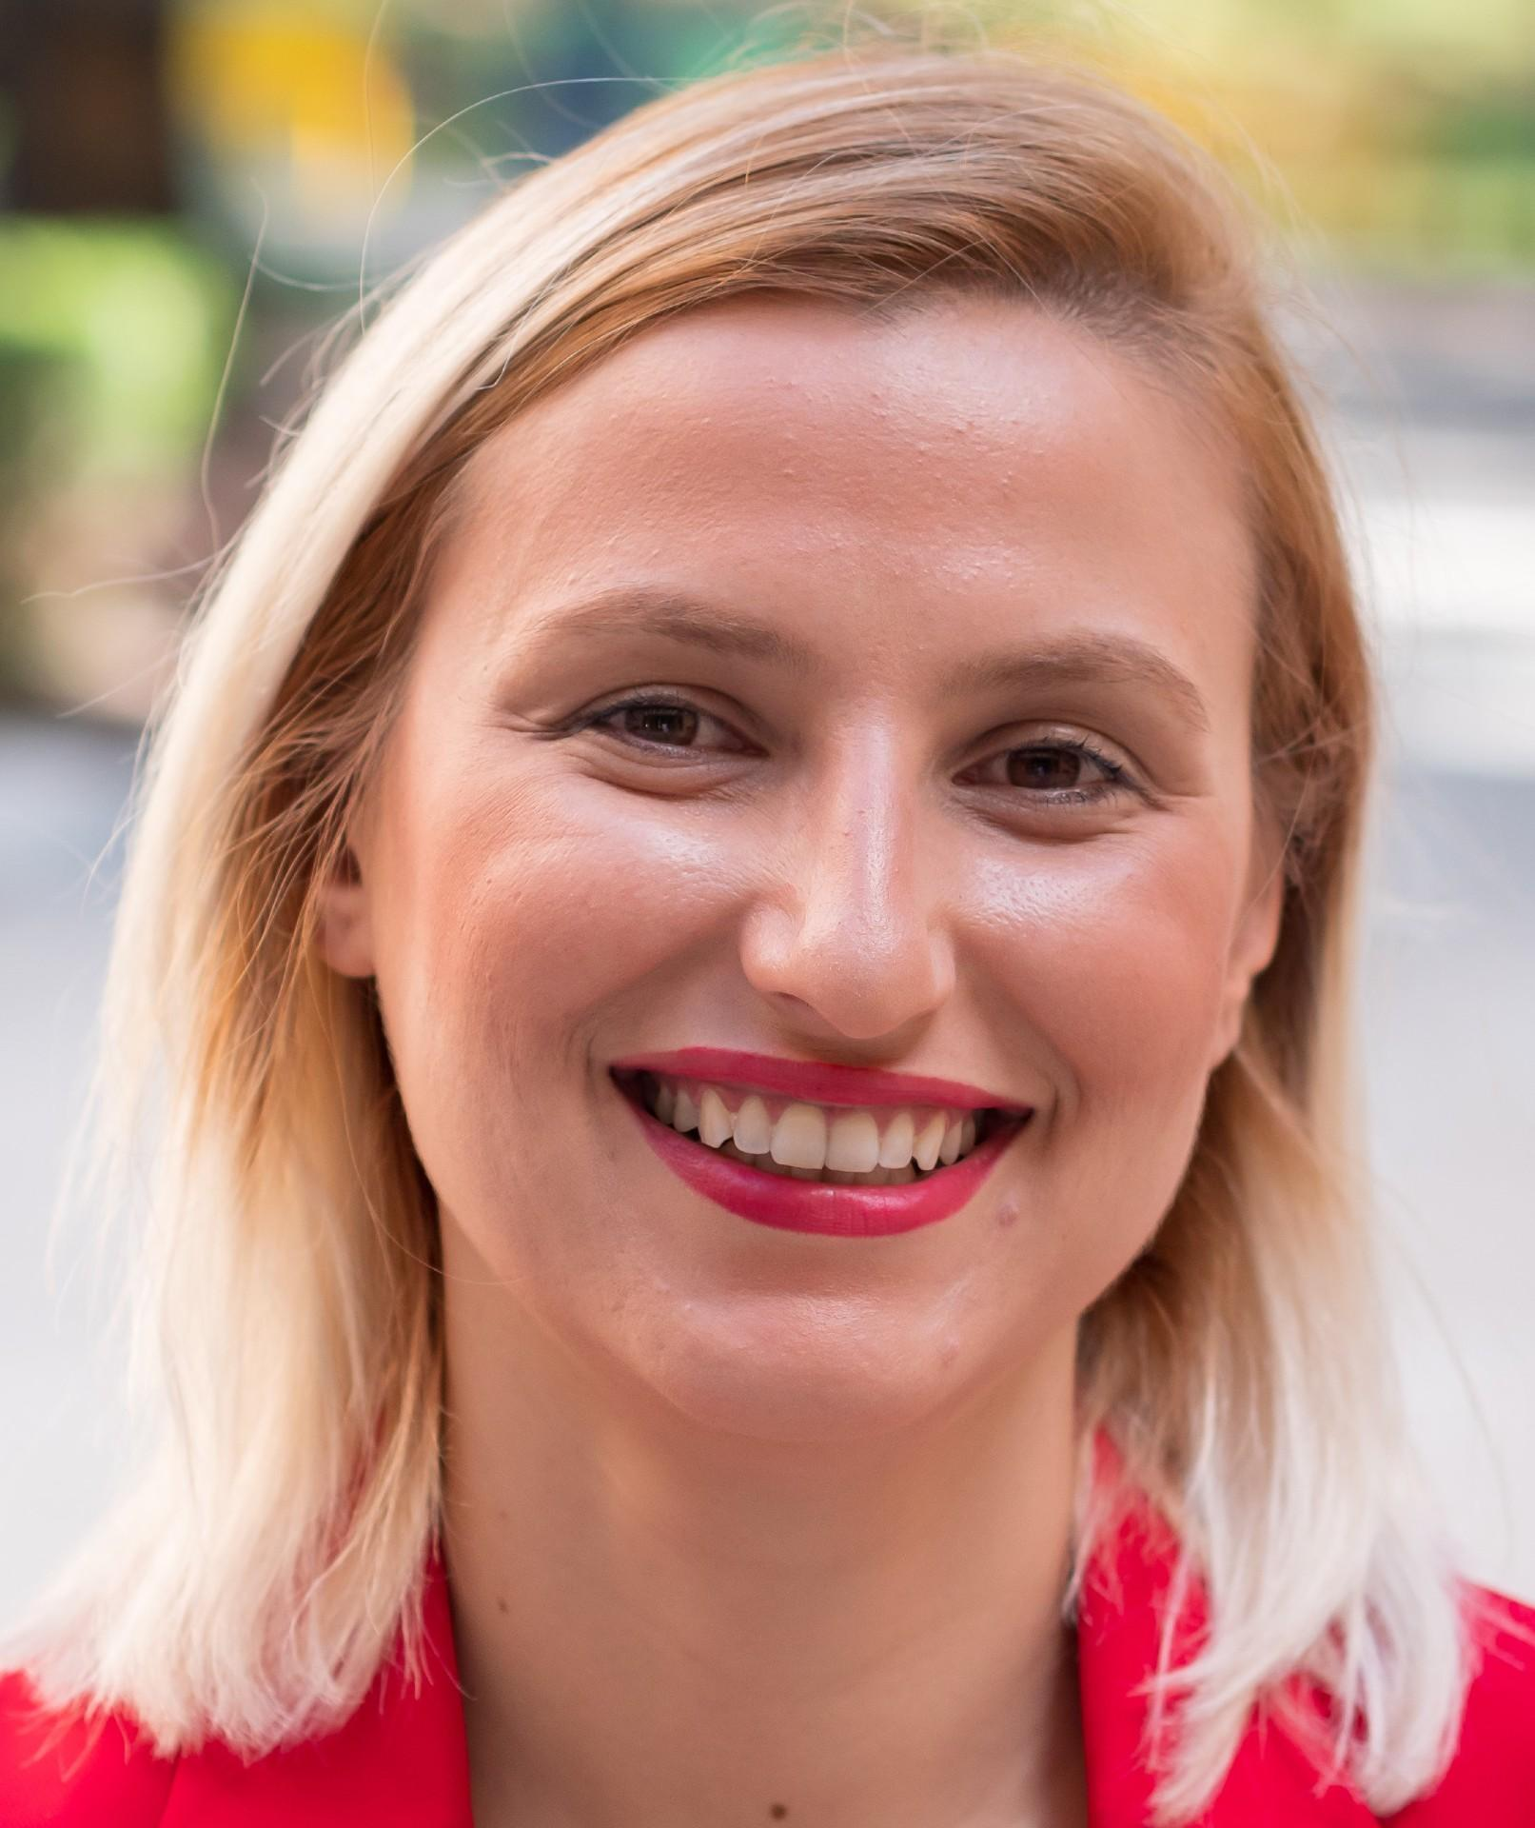
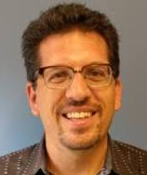
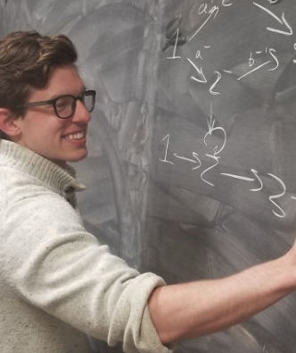
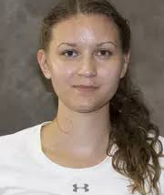

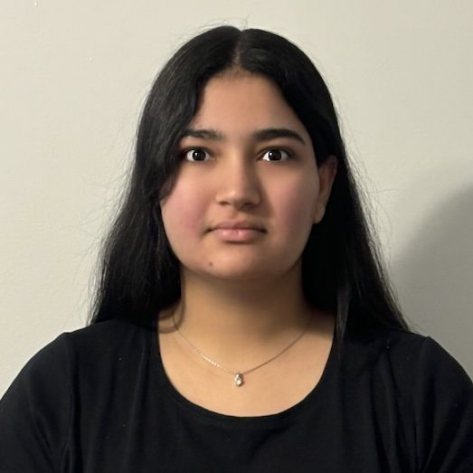
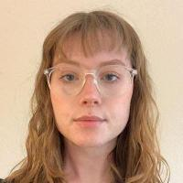
Getting to know each other
The Statistics and Research Summer Program at Saint Louis University (STARS@SLU)
Summer 2025
Özlem Uğurlu
Director
Bryan Clair
Co-director
Cody Gilbert
Co-director
Alina Abdurakhimova
Graduate Assistant & Mentor
Sasha Trejo-Arciles
Undergraduate Assistant & Mentor
Preetinder Kaur
Undergraduate Assistant & Mentor
Ava Robertson
Undergraduate Assistant & Mentor

Slide 4

The Statistics and Research Summer Program at Saint Louis University (STARS@SLU)
Summer 2025
Introduce yourselves; including name, school and grade!

Slide 5
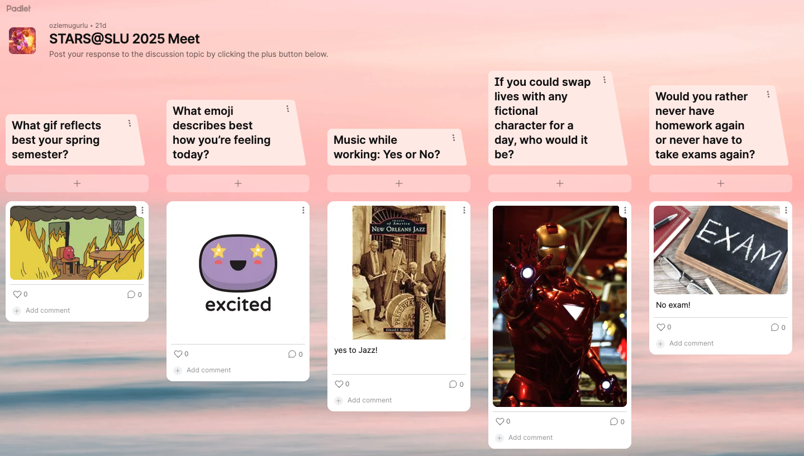
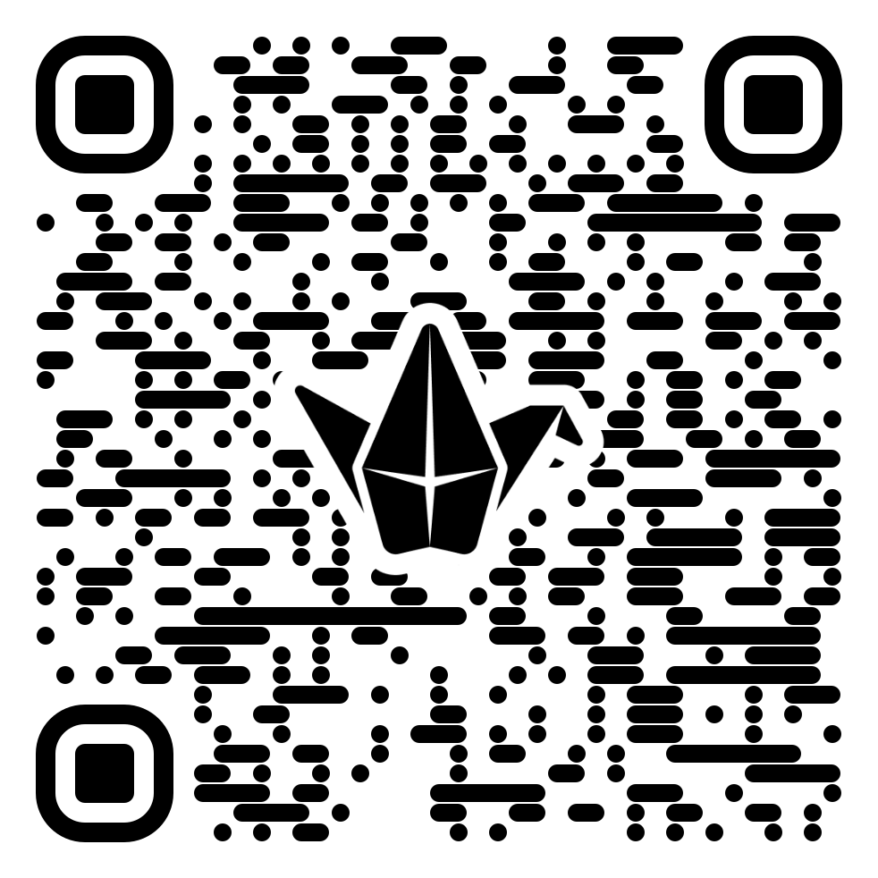
The Statistics and Research Summer Program at Saint Louis University (STARS@SLU)
Summer 2025
Let’s learn more about each other.

Slide 6
Outline of the Program
The Statistics and Research Summer Program at Saint Louis University (STARS@SLU)
Summer 2025
01
02
03
Week 1
Week 2
Last Day
Hands-on workshop
Sessions on Academic and Career Growth
Mentoring sessions
Campus Tours
Game Sessions
Group Projects
Poster Preparation Sessions
Mentoring Sessions
Invited Speakers
Game Sessions
Poster Presentation
Certificate of Completion
Closing Remark & Reception

Slide 7
The Statistics and Research Summer Program at Saint Louis University (STARS@SLU)
Summer 2025
Highlight the research component, projects
Research

Slide 8

The Statistics and Research Summer Program at Saint Louis University (STARS@SLU)
Summer 2025
Student mentors will support you through the program
Mentoring helps you:
• Build confidence and navigate challenges
• Develop a stronger sense of belonging in mathematical community
• Gain access to resources, networks, and opportunities
• Learn from someone who has been in your shoes
This is your support system. You’re not alone in this journey.
Mentoring

Slide 9
The Statistics and Research Summer Program at Saint Louis University (STARS@SLU)
Summer 2025
Prior to your first meeting with your mentor, write down a few things you might want help with. Rank the items in order of importance to you. Also write down things, if any, that concern you most about meeting with your mentor. Rank these things in order of importance.
Write down things you would like your mentor to provide to make the most of the mentoring opportunity.
The focus of most successful mentoring is mutual learning. Feel free to explore what you have to offer the mentor. A sense of humor and a sense of enjoyment of your time together are essential as well.
Mentoring

Slide 10

The Statistics and Research Summer Program at Saint Louis University (STARS@SLU)
Summer 2025
Academic and Career Growth
Learning and development opportunities through panel and invited speaker sessions.
At a glance
What to know about College Life
How to apply to a College
Summer Opportunities
Careers in STEM

Slide 11
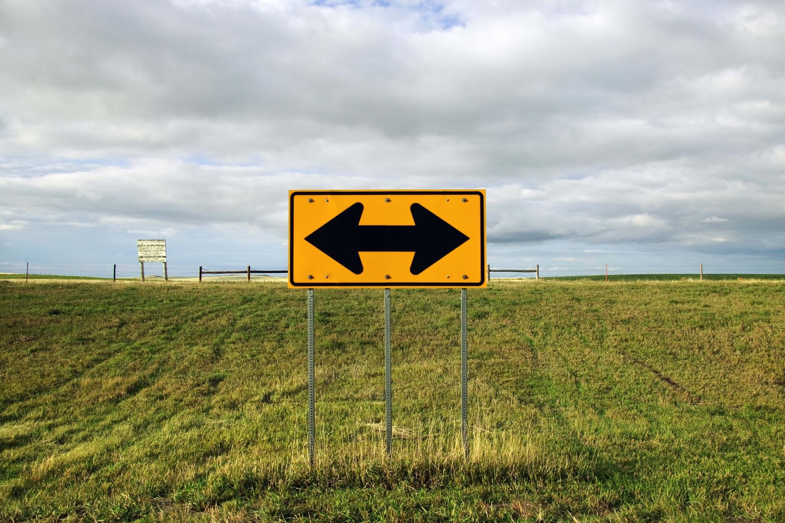

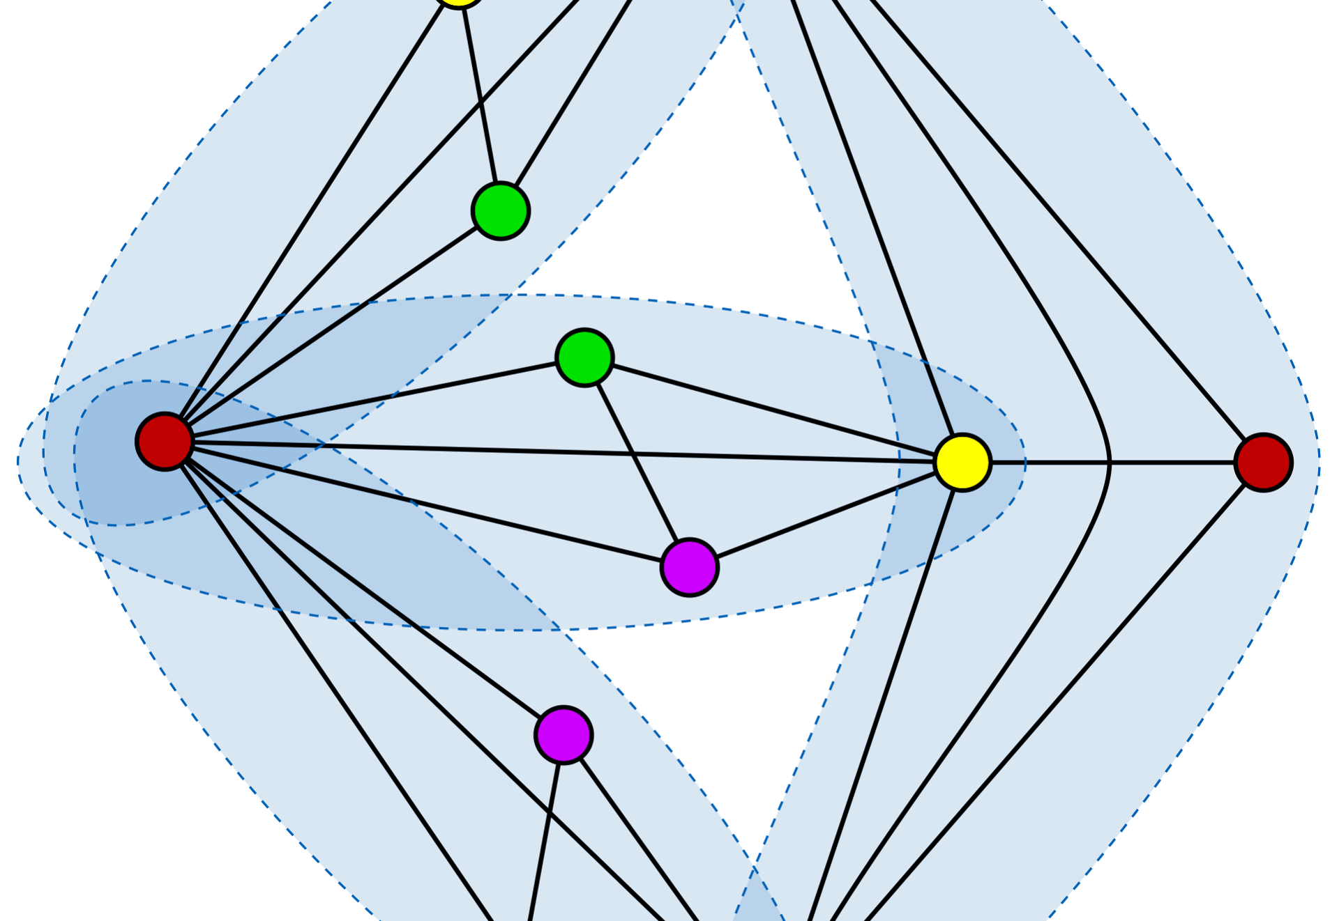
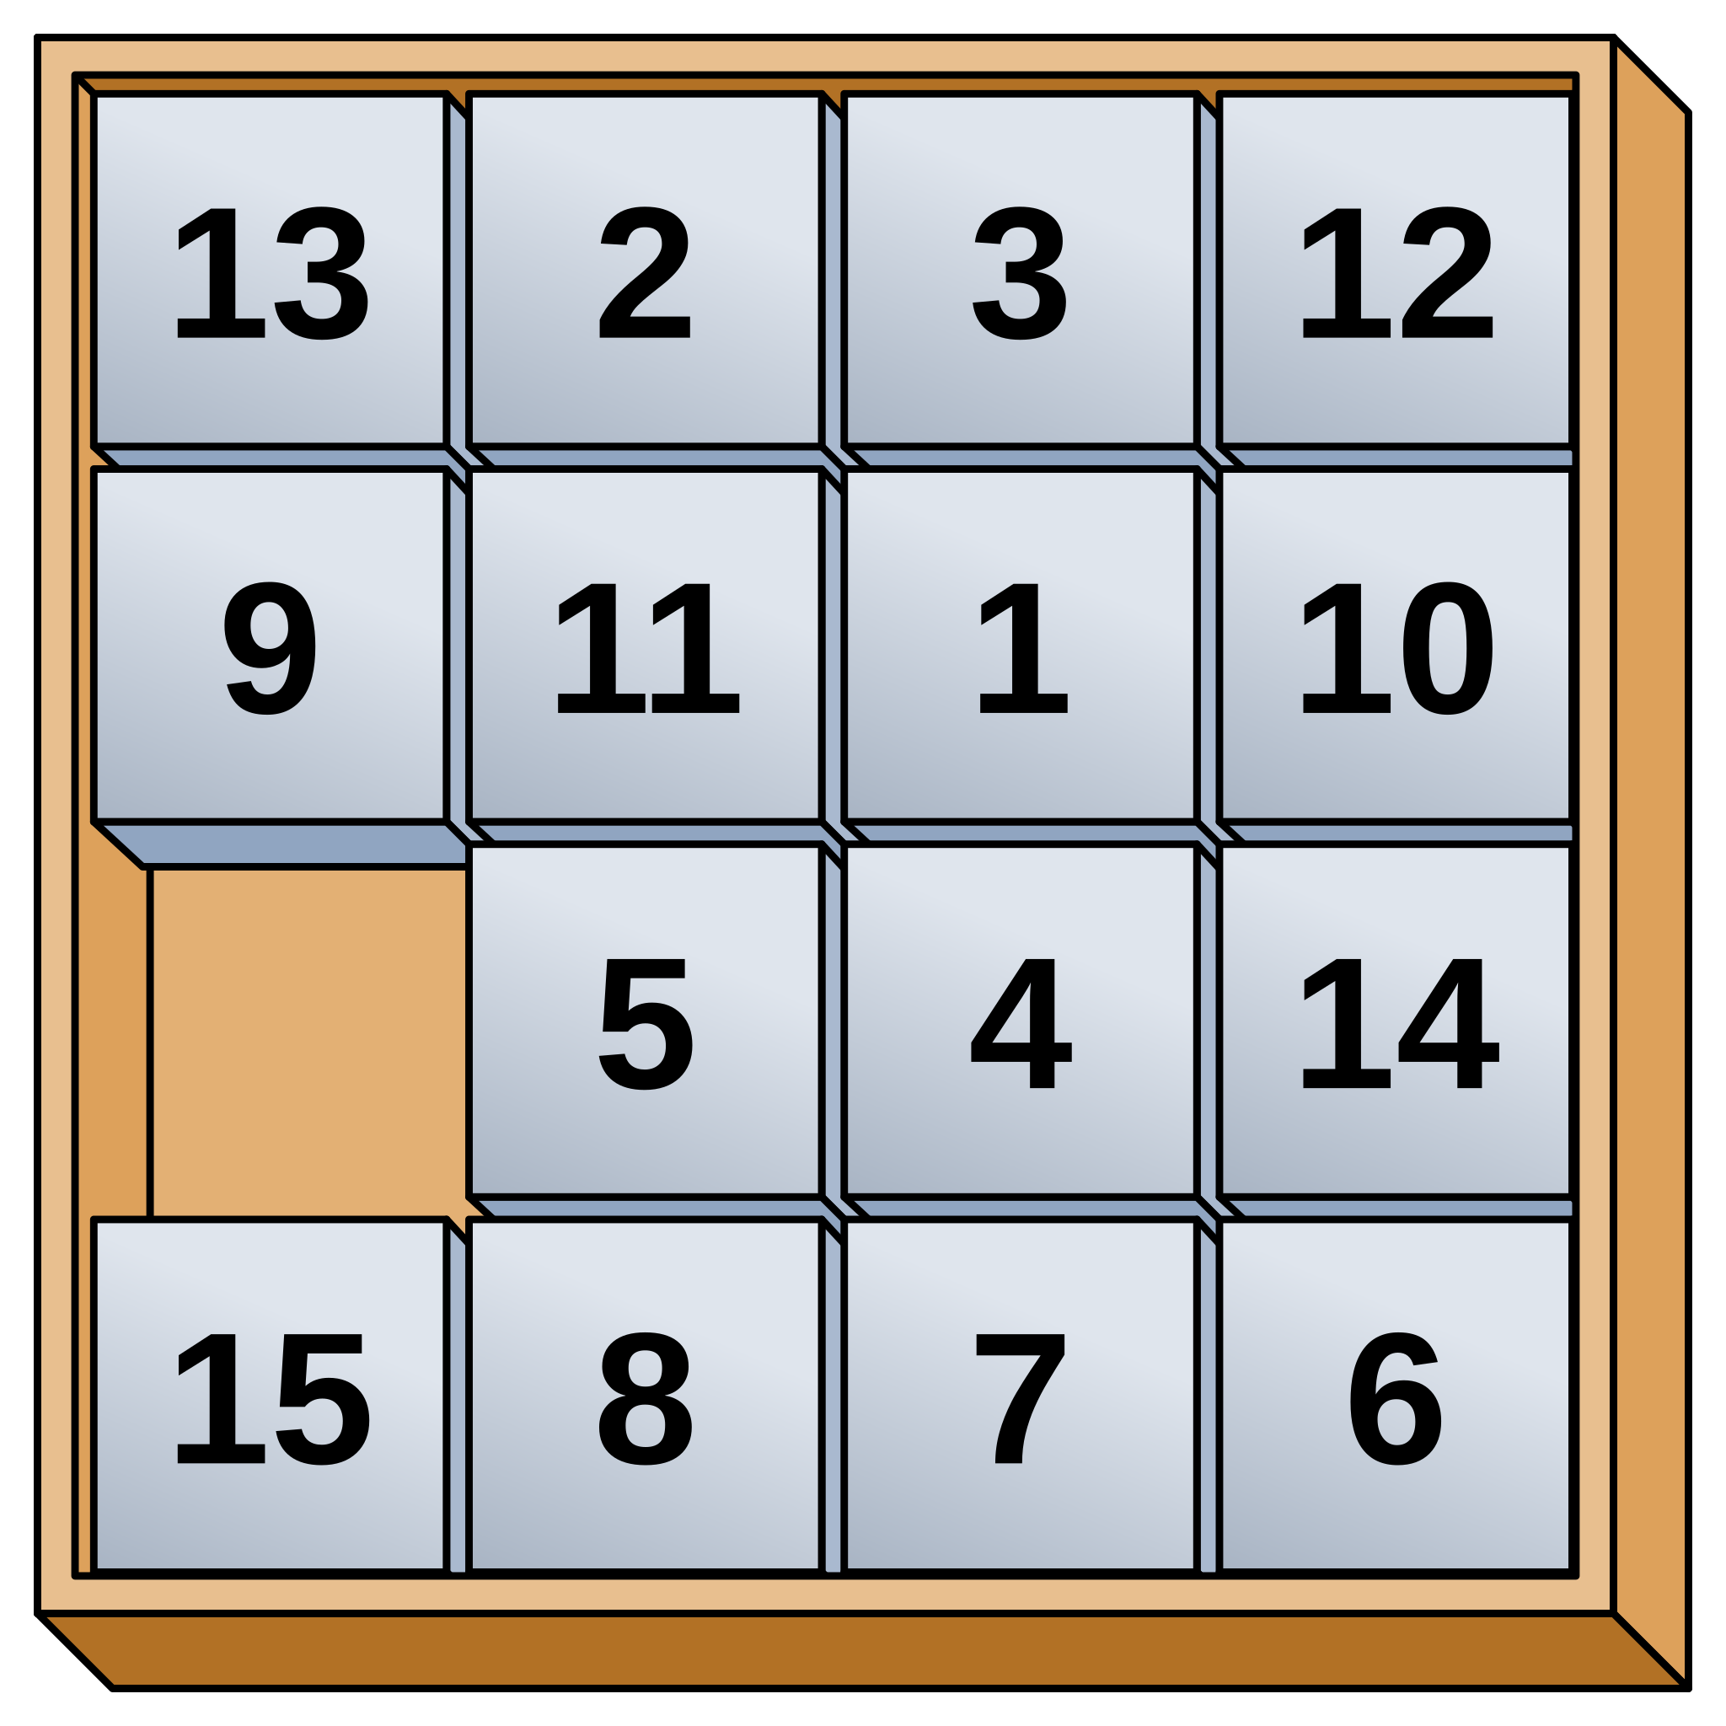



Game Session
The Statistics and Research Summer Program at Saint Louis University (STARS@SLU)
Summer 2025
01
02
03
Telestration
Function Battleship
Data Manipulation
04
05
Planar Graphs
Game of Fifteen

Slide 12

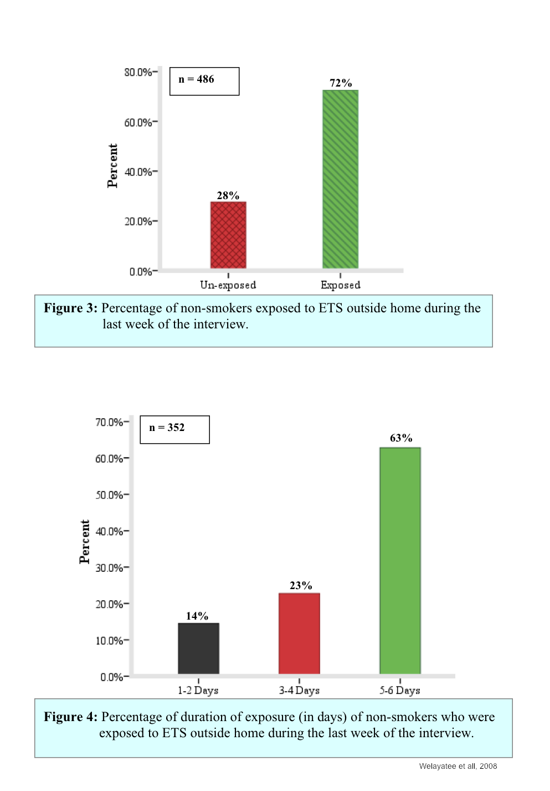
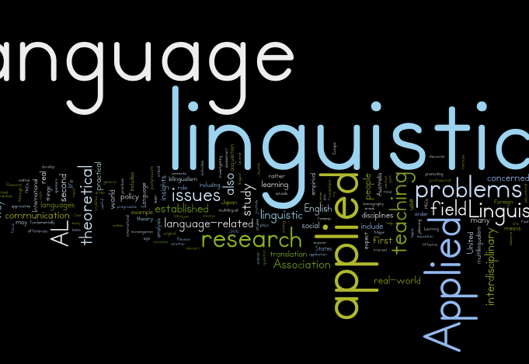
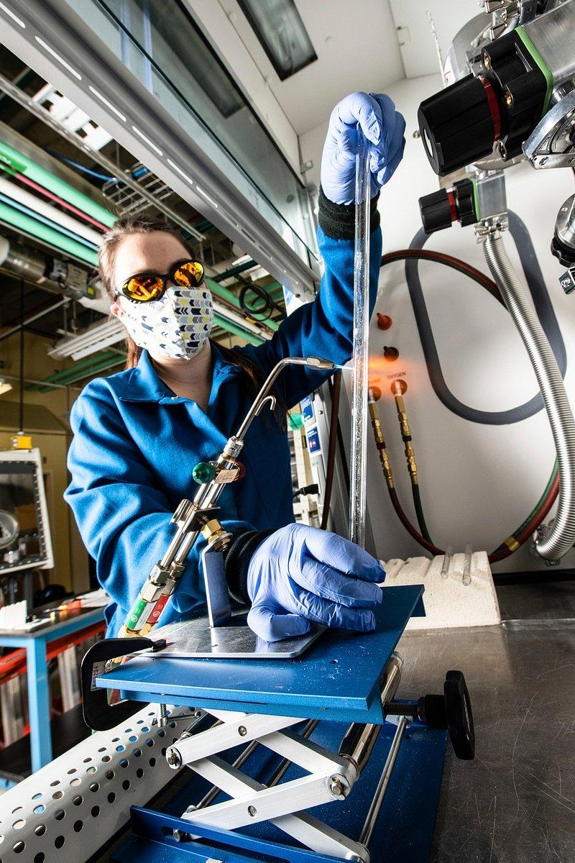


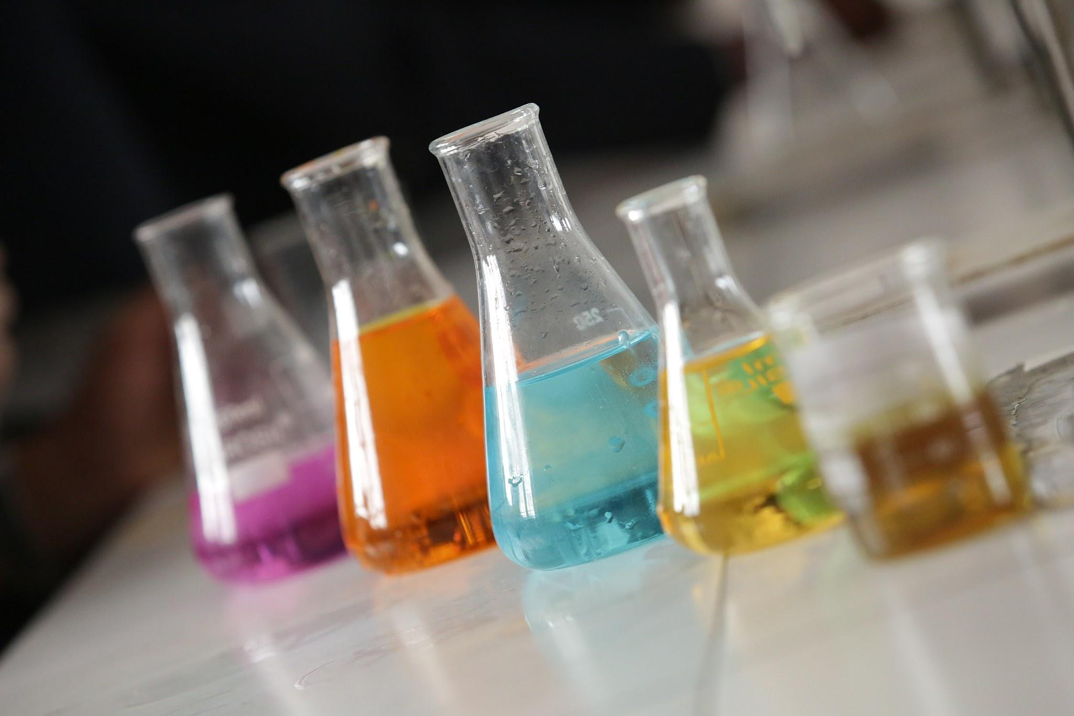
Invited Speakers
The Statistics and Research Summer Program at Saint Louis University (STARS@SLU)
Summer 2025
01
02
03
04
05
Literatures
Biostatistics
Computer Science
Electrochemical Engineering
Chemistry
Dr. Ander Beristain & Dr. Andre Zampaulo
Dr. Nikki Freeman
Dr. Abby Stylianou
Dr. Erfan Asadipour
Dr. Michael Hankins

Slide 13
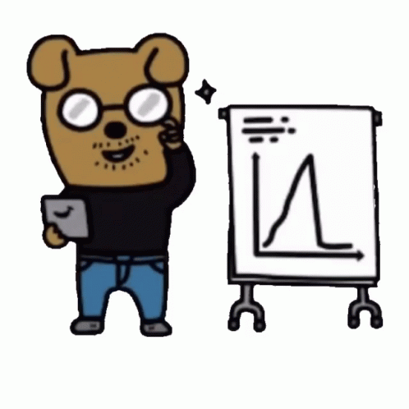

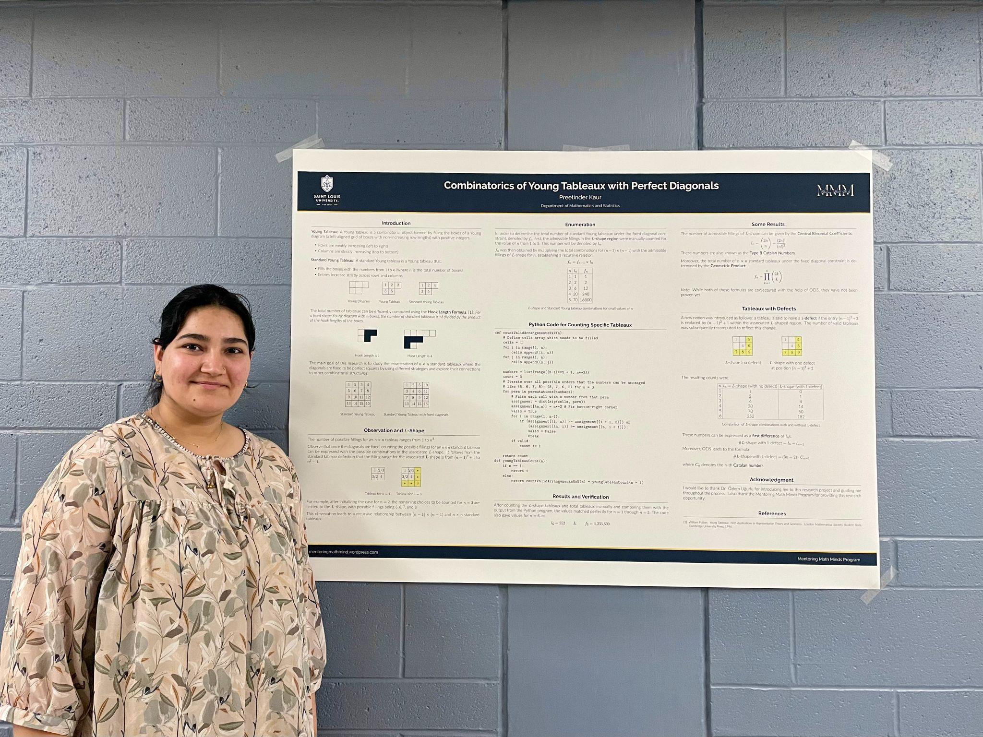
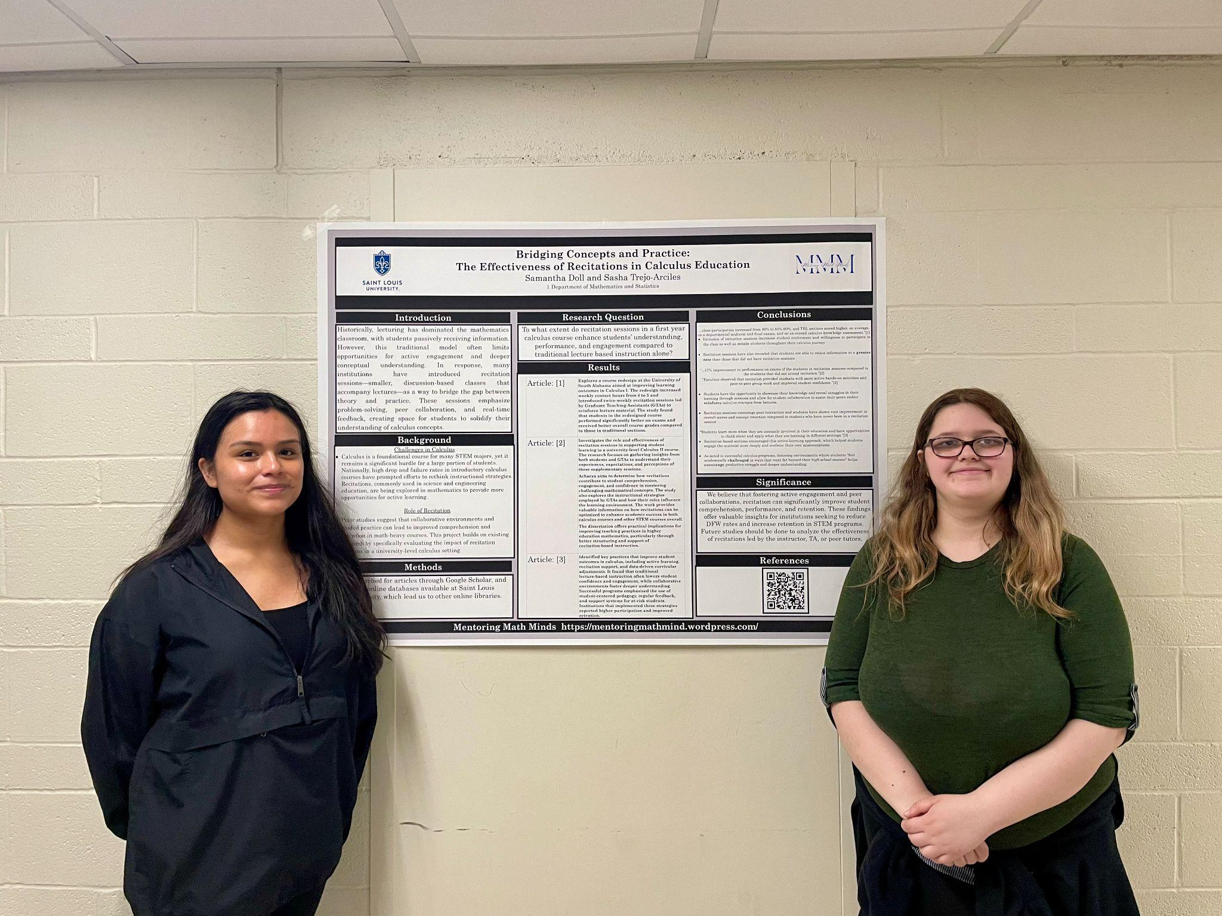
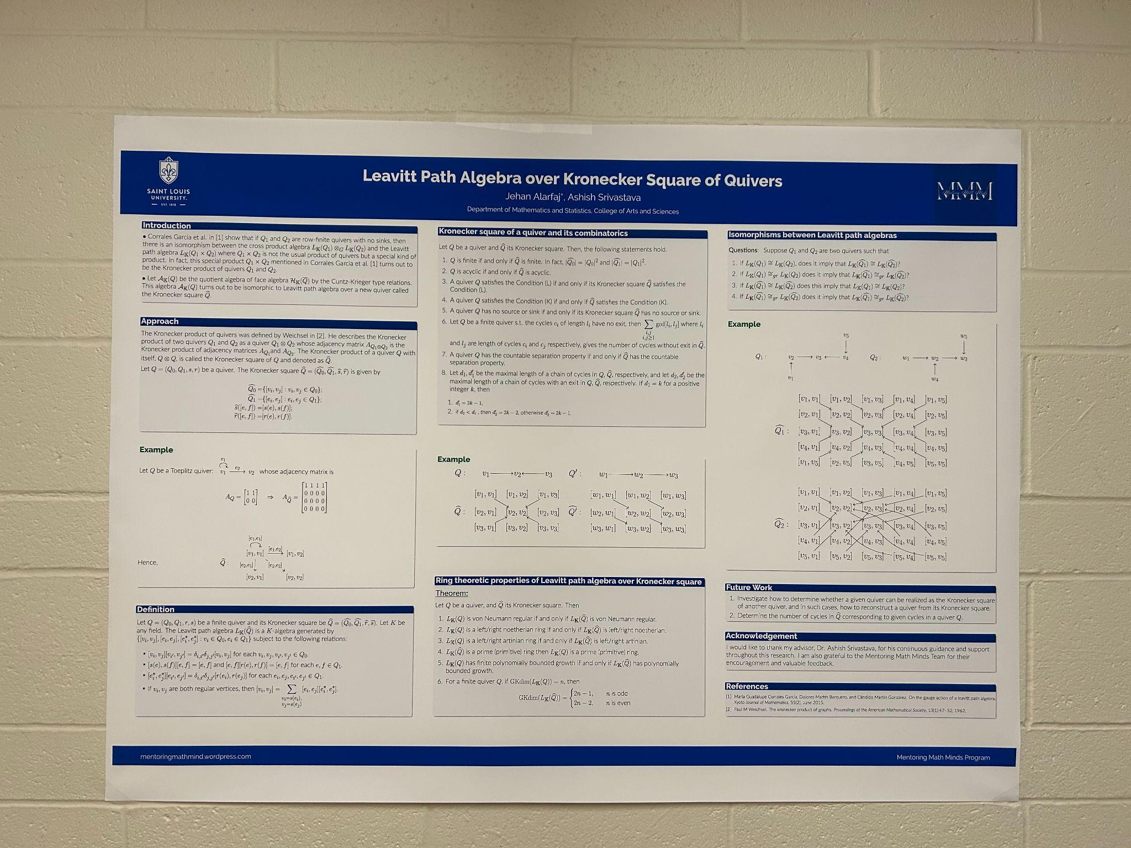
Poster Presentation
The Statistics and Research Summer Program at Saint Louis University (STARS@SLU)
Summer 2025
Provide some project details.
Project details
Due Date: Make sure to prepare your posters by Thursday, August 7th, 5PM
Location: ISE Lobby
Preparation: Friday, August 8th by noon
Poster Session: Friday, August 8th, 1-2pm
See the projects on our website: stars-slu.github.io/2025/

Slide 14
Checklist
01
02
03
04
Logistic
Stipend and Travel
Support
Signed Forms
Program Materials
The Statistics and Research Summer Program at Saint Louis University (STARS@SLU)
Posting on Social Media?
Tag MAA!
Summer 2025
#MAAGrants #MAAPrograms #MAA #MathGrants
Breakfast: In front of ISE 230
Sessions & Workshops: ISE 230
Lunch: Grand Dining Hall
Picnic on Wednesdays
SLU Photo Release Form
Liability Waiver
Health Medical Release Form
Community Agreement Form
All the materials will be available on GitHub site: stars-slu.github.io/2025/
Program Website: https://stars-slu.github.io/homepage/
Stipend: Your information was shared with Sara Baumann. Expect an email from her.
Travel: Keep the receipts and other forms needed. You will be reimbursed for the transportation.

Slide 15
What is Next for the day?
01
02
03
04
Workshop - Part I
Workshop - Part II
Campus Tour
Mentoring Session
The Statistics and Research Summer Program at Saint Louis University (STARS@SLU)
Summer 2025
Team or lead: Will be led by Visit SLU Staff, starting from the ISE building
Objective: Explore the SLU North Campus
Time: 3 - 4 pm
Team or lead: Led by Student Mentors
Objective: Meeting with mentors, setting goals
Time: 4:15- 5:00 pm
Briefly summarize workshop.
Team or lead: Who'll carry it out?
Objective: What's the goal?
Time: 10 - 11:30 am
Briefly summarize workshop.
Team or lead: Who'll carry it out?
Objective: What's the goal?
Time: 1 - 2:30 pm

Slide 16
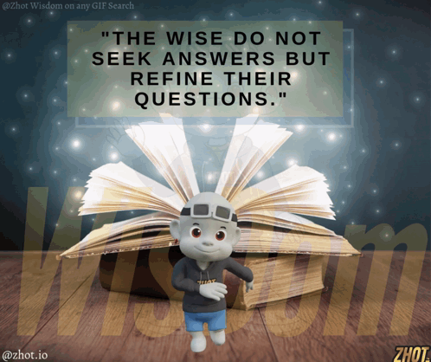


Thank you
Questions?

